Slide 1

End Sem Project Presentation
MULTIMODAL
SENTIMENT ANALYSIS
K Supiya

Slide 2
Content
Problem Statement
Introduction
Dataset Description
Literature Survey
Implementation
Result
Conclusion and Future Scope
References

Slide 3
Problem Statement
Developing a multi-modal emotion recognition system integrating facial expression analysis, voice/speech analysis, and text sentiment analysis.This system must accurately identify and classify human emotions across these modalities using computer vision techniques for facial expression analysis, advanced audio analysis for voice/speech processing, and natural language processing for text sentiment analysis.

Slide 4
Introduction
Multi-modal emotion recognition aims to identify and classify human emotions across facial expressions, voice/speech, and text sentiment analysis.
Similar to speaker recognition, it involves recognizing individuals based on unique emotional characteristics.
Motivated by applications in security, forensic analysis, and voice-activated systems.
Holds promise for revolutionizing human-computer interaction and enhancing user experiences.

Slide 5
Dataset Description (Sentiment Analysis Using Text)
Emotions dataset for NLP
Number of Files: 3
train.txt: Training dataset
test.txt: Testing dataset
val.txt: Validation dataset
Total Size: 206.76 kB(training dataset), 1.66MB(testing dataset), 204.24kB(validation dataset)
Data Format: Text files containing textual data for sentiment analysis.
List of documents with emotion flag, dataset is split into train, test & validation for building the machine learning model

Slide 6
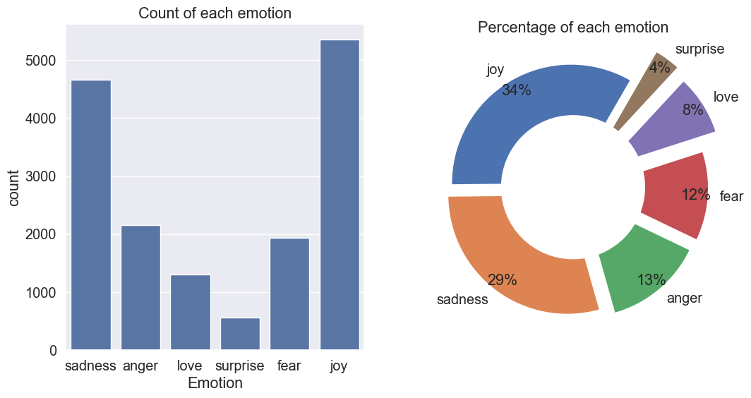
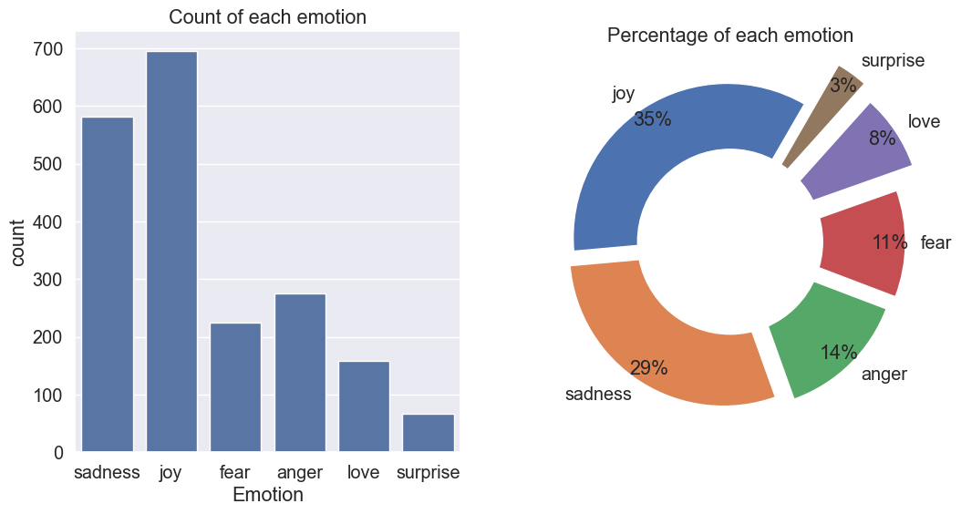
Dataset Description (Sentiment Analysis Using Text)
train.txt: Training dataset
test.txt: Testing dataset

Slide 7
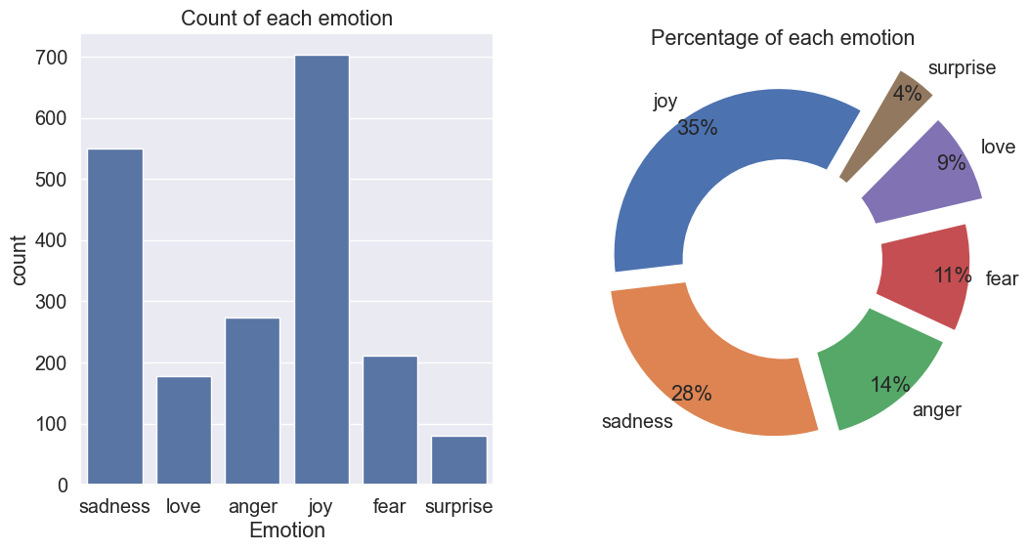
Dataset Description (Sentiment Analysis Using Text)
val.txt: Validation dataset
LINKS:
https://www.kaggle.com/code/dadaji/sentiment-analysis/input?select=test.txt
https://www.kaggle.com/code/dadaji/sentiment-analysis/input?select=train.txt
https://www.kaggle.com/code/dadaji/sentiment-analysis/input?select=val.txt

Slide 8
Dataset Description (Sentiment Analysis Using Speech)
Ryerson Audio-Visual Database of Emotional Speech and Song (RAVDESS)
This portion of the RAVDESS contains 1440 files: 60 trials per actor x 24 actors = 1440
RAVDESS contains 24 professional actors (12 female, 12 male)
Emotions includes calm, happy, sad, angry, fearful, surprise, and disgust.
The filename consists of a 7-part numerical identifier (e.g., 03-01-06-01-02-01-12.wav). These identifiers define the stimulus characteristics:
Dataset link- https://www.kaggle.com/datasets/uwrfkaggler/ravdess-emotional-speech-audio/data

Slide 9
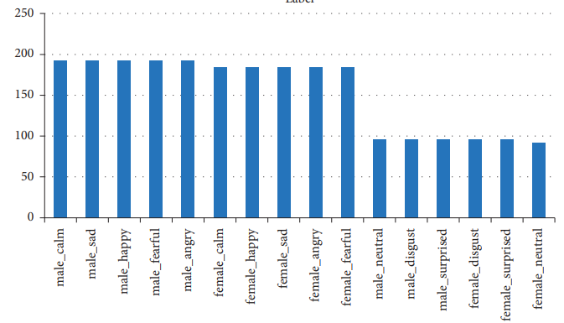
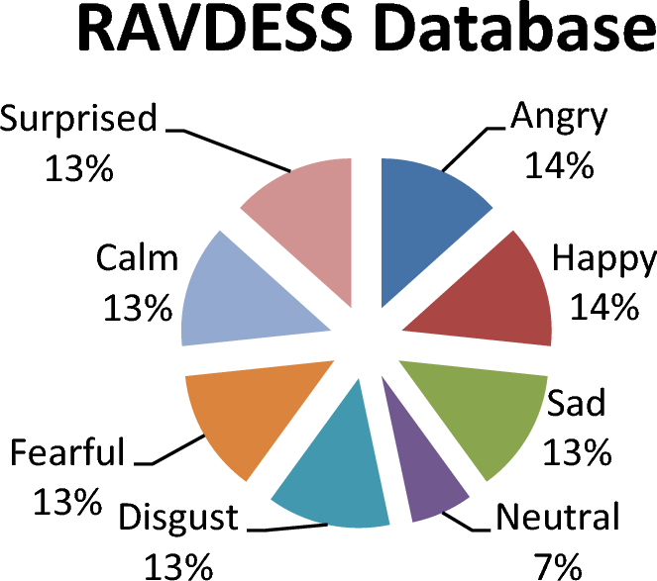
Dataset Description (Sentiment Analysis Using Speech)

Slide 10
Dataset Description(Sentiment Analysis Using Facial Recognition)
FER-2013
The data consists of 48x48 pixel grayscale images of faces. The faces have been automatically registered so that the face is more or less centred and occupies about the same amount of space in each image.
The task is to categorize each face based on the emotion shown in the facial expression into one of seven categories (0=Angry, 1=Disgust, 2=Fear, 3=Happy, 4=Sad, 5=Surprise, 6=Neutral).
The training set consists of 28,709 examples and the public test set consists of 3,589 examples.
Dataset link- https://www.kaggle.com/datasets/msambare/fer2013/data

Slide 11
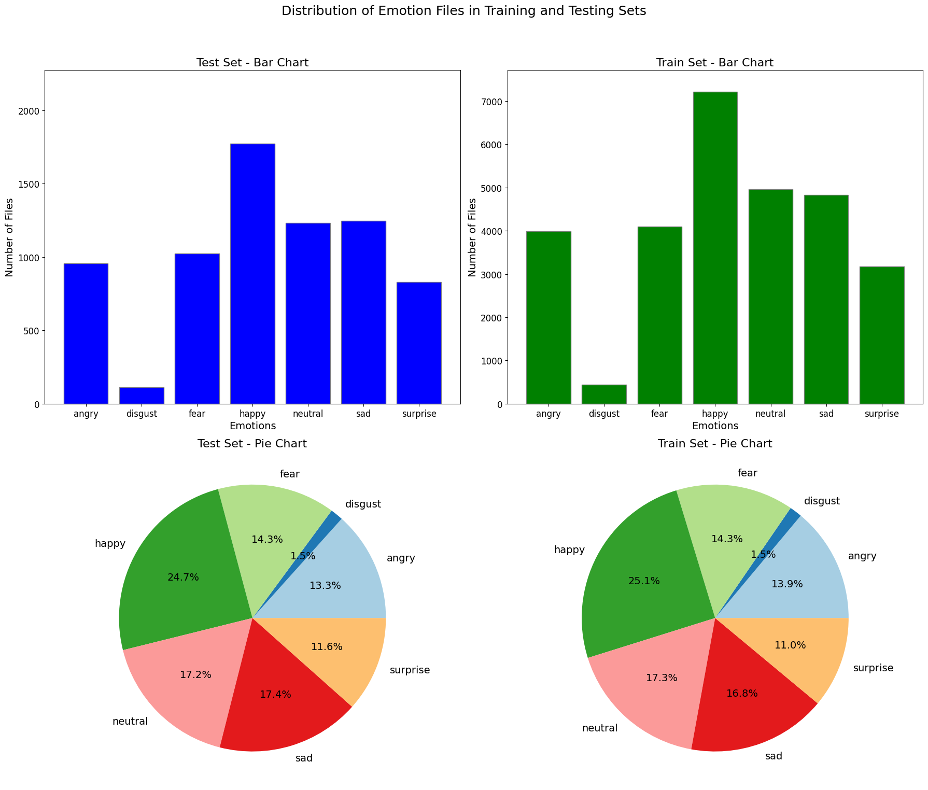
Dataset Description(Sentiment Analysis Using Facial Recognition)

Slide 12
Dataset Description(Sentiment Analysis Using Facial Recognition)

Slide 13
Literature Survey
[2] The study uses a neural network model with OpenCV for group facial emotion analysis, achieving a 90.5% accuracy rate. It combines CNN models and OpenCV for precise feature extraction and real-time applications in security and human-computer interaction.
[3] This study presents a sentiment analysis model for job interviews using supervised ML and ANN. It includes eye tracking to analyze participants' eye movements during questions. The model uses an MLP with two hidden layers, a sigmoid function, and input normalization, featuring a client-server model with a web-based interface.
[4] The study improves facial emotion recognition by fusing CNN and LBP, and using transfer learning on datasets like CASIA WebFace and SFEW, achieving a 15% accuracy improvement. It demonstrates the practical use of CNNs in real-time emotion detection.

Slide 14
Literature Survey
[5] The paper "Emotion Detection of Contextual Text using Deep Learning" introduces the Aimens system, which uses a Bi-LSTM model with word2vec and doc2vec embeddings for emotion detection in conversations, achieving an F-score of 0.7185. The system enhances understanding of user emotions and human-computer interaction through hyper-parameter tuning and improved preprocessing.
[6] This study develops a real-time algorithm for lie detection based on facial expressions during conversations. It identifies six key facial features linked to lying, such as blinking rate and eyebrow movements, using computer vision and signal processing. The model employs the Viola-Jones algorithm for feature extraction and discusses related works and experimental results in facial lie detection.

Slide 15
Models Used
Random Forest: Random Forest is like a group of decision trees each specialized in recognizing different emotions. When a new text comes in, each tree votes on which emotion it thinks the text expresses. The forest then aggregates the votes to predict the primary emotion based on the majority opinion of all the trees.
Logistic Regression: Logistic Regression is like drawing a dividing line through a cloud of points, where each point represents a piece of text and the line separates them into different emotion categories. logistic regression calculates the probability that a piece of text belongs to each emotion category.
Decision Tree: Decision Tree is like playing a game of multiple-choice questions about emotions. It asks a series of questions based on the features of the text, gradually narrowing down the possibilities until it reaches a conclusion about the primary emotion expressed in the text.

Slide 16
Models Used
Support Vector Machine (SVM) : Support Vector Machine is like finding the best hyperplane to separate different emotions in a high-dimensional space of text features. It identifies the optimal boundary that maximizes the margin between different emotion categories, enabling accurate classification of text into the appropriate emotion classes.
K-nearest Neighbor (KNN) Classifier: K-nearest Neighbor is like consulting with the closest neighbors to determine the primary emotion expressed in a piece of text. It looks at the emotions of similar texts (neighbors) based on their feature representations and assigns the primary emotion based on the majority vote of its k nearest neighbors.
Convolutional Neural Networks (CNNs): They deep learning models tailored for structured grid data like images and audio. With layers of filters, they learn hierarchical features, making them adept at tasks such as image and speech recognition.

Slide 17
Models Used
Gradient Boosting: Gradient boosting is a machine learning technique that builds an ensemble of weak learners (typically decision trees). It iteratively adds models to correct errors of the combined model, optimizing performance by minimizing the loss function with each new model.
RNN : A Recurrent Neural Network is like a person reading a message word by word, remembering the previous words as context to understand the emotion of the text. It processes each word in the message sequentially, updating its internal state based on both the current word and the context from previous words. This allows it to capture the sequential nature of language and make predictions about the emotion of the text.

Slide 18
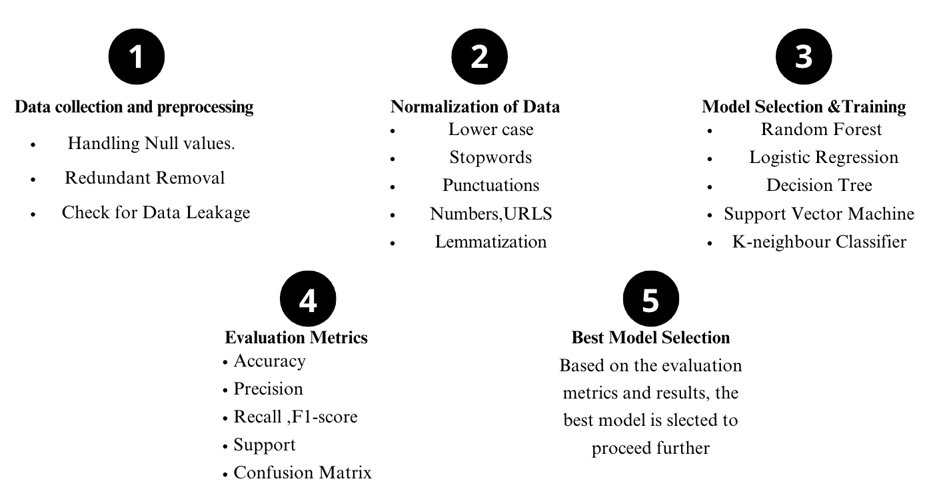
Implementation (Sentiment Analysis Using Text)

Slide 19
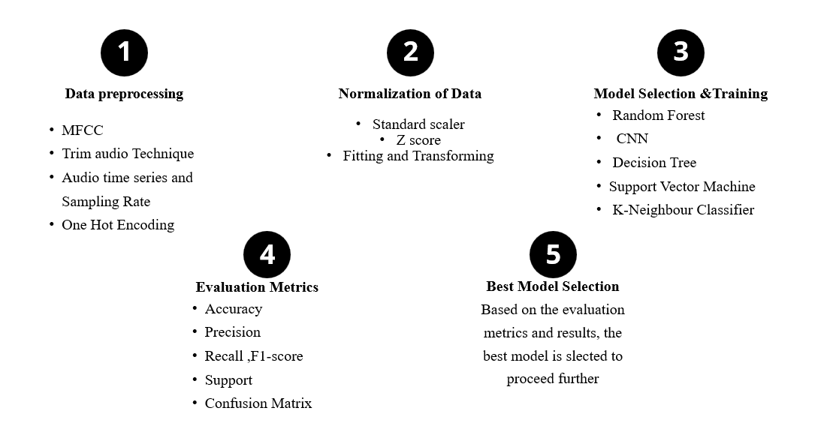
Implementation (Sentiment Analysis Using Speech)

Slide 20
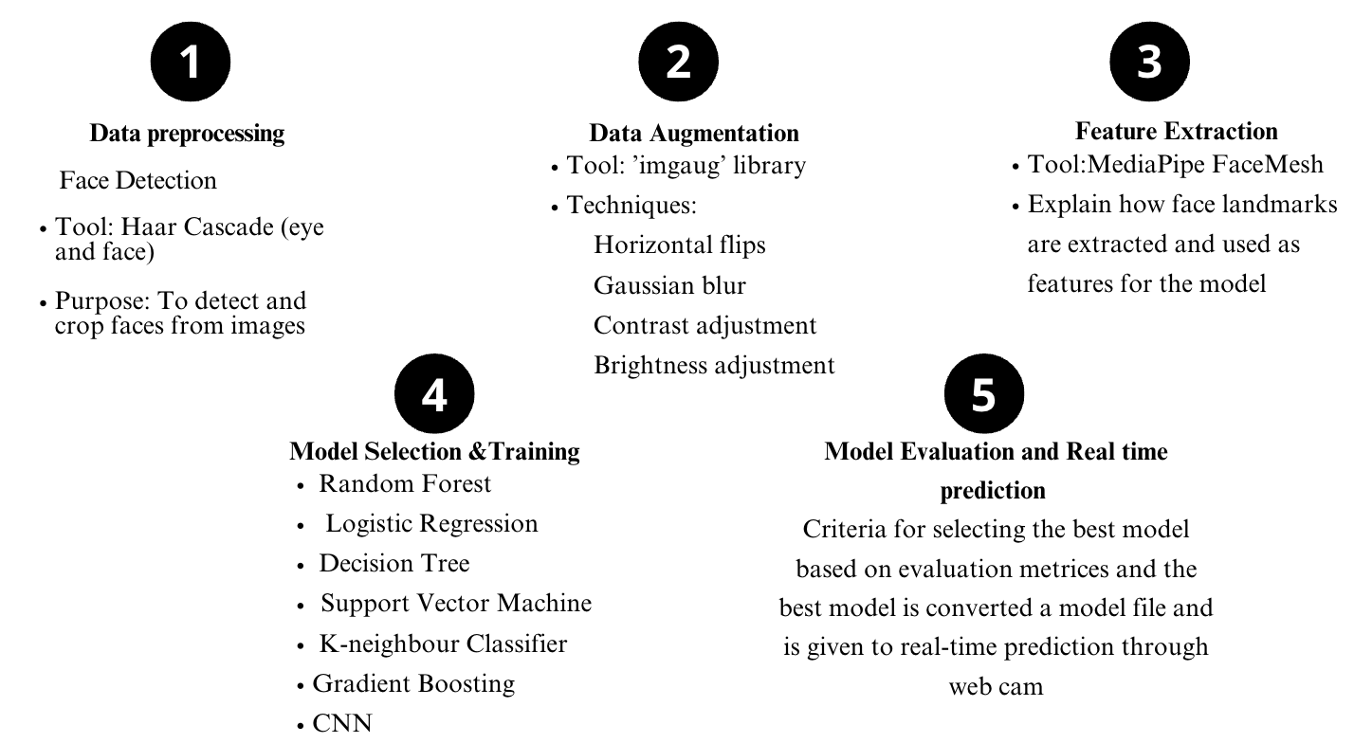
Implementation (Sentiment Analysis Using Facial Recognition)

Slide 21
Result (Sentiment Analysis Using Text)
SL NO. | MODEL USED: | ACCURACY:
 | Random Forest | 0.8890
2. | Logistic Regression | 0.8685
3. | Decision Tree | 0.8595
4. | Support Vector Machine (SVM) | 0.8055
5. | K-nearest Neighbor (KNN) Classifier | 0.7925
Random Forest: (Best Model)
Accuracy: 0.8890
Description: Random Forest performed the best among the models, achieving the highest accuracy in classifying text into six different emotions. Its ensemble of decision trees allowed it to effectively capture the complex relationships between features and emotions in the text data.

Slide 22
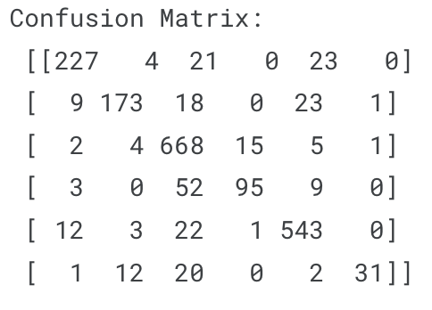
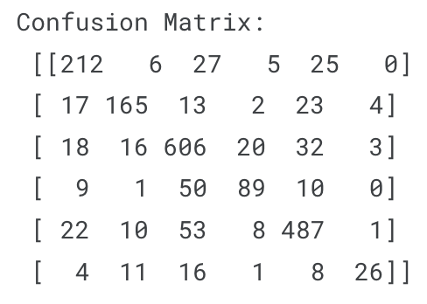
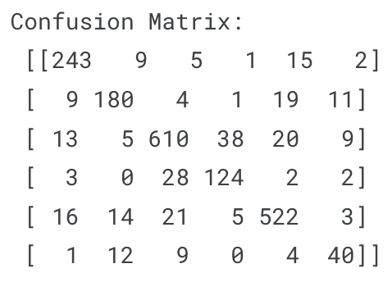
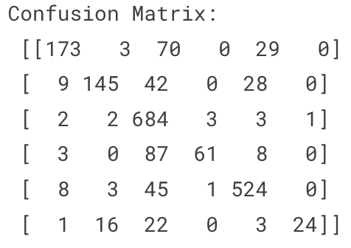
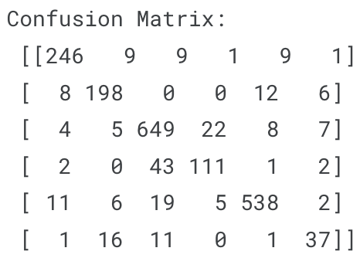
Result (Sentiment Analysis Using Text)
Logistic Regression
K- Nearest Neighbour
Decision Tree
Support Vector Machine
Random Forest

Slide 23
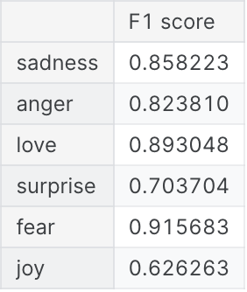
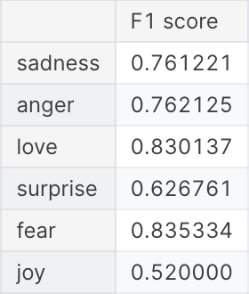
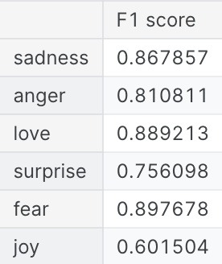
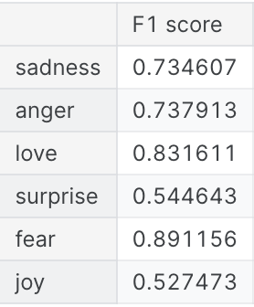
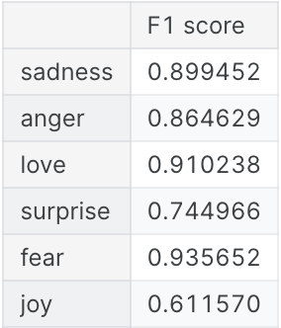
Result (Sentiment Analysis Using Text)
Logistic Regression
K- Nearest Neighbour
Decision Tree
Support Vector Machine
Random Forest

Slide 24
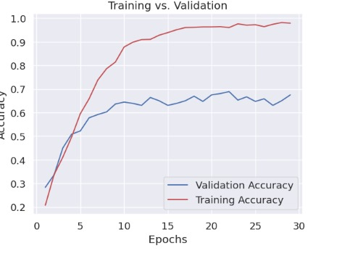
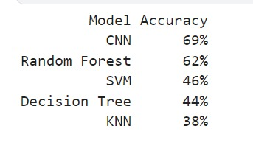
Result (Sentiment Analysis Using Speech)
The Convolutional Neural Network (CNN) demonstrated a 69% accuracy rate in classifying emotions from audio recordings, indicating its effectiveness in this task.
CNNs are well-suited for capturing complex patterns in voice data, making them a promising approach for robust emotion recognition in real-world applications.

Slide 25
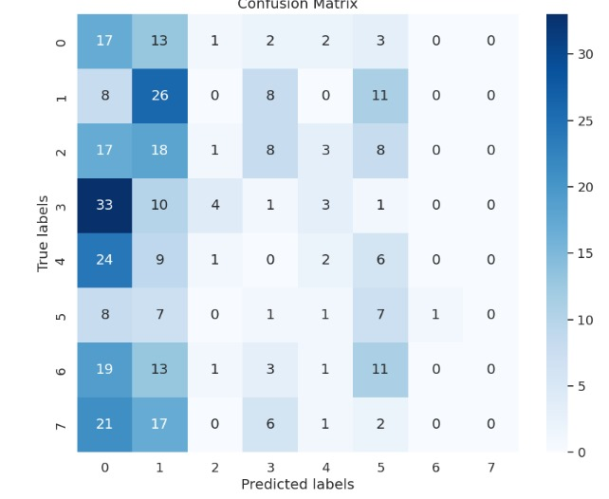
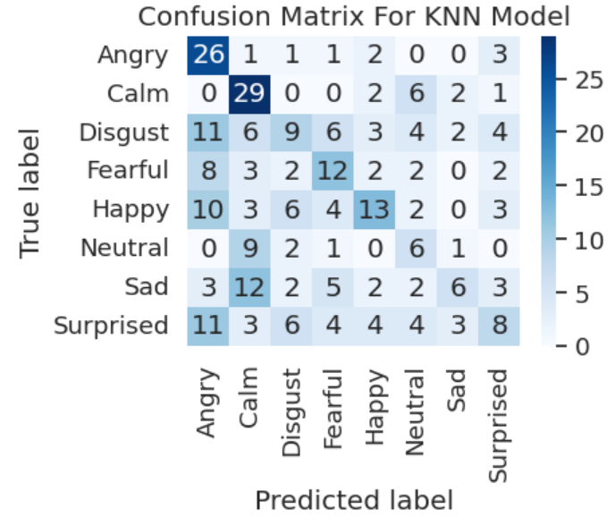
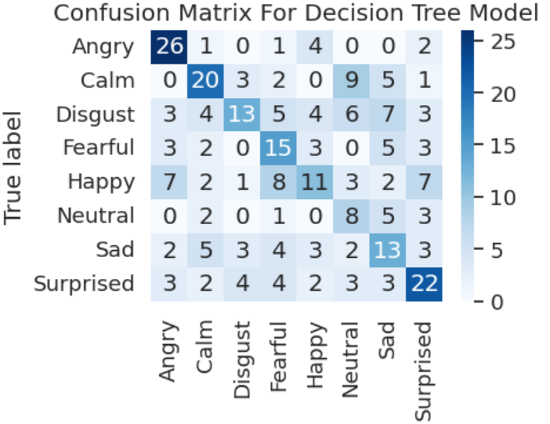
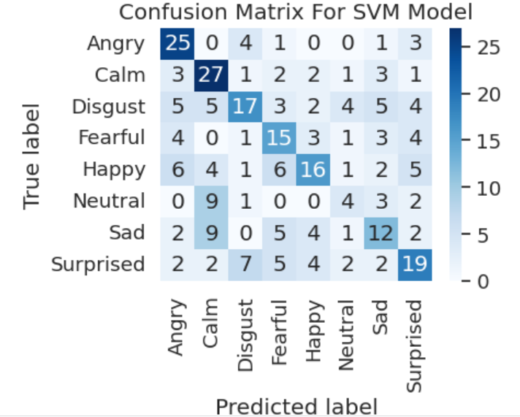
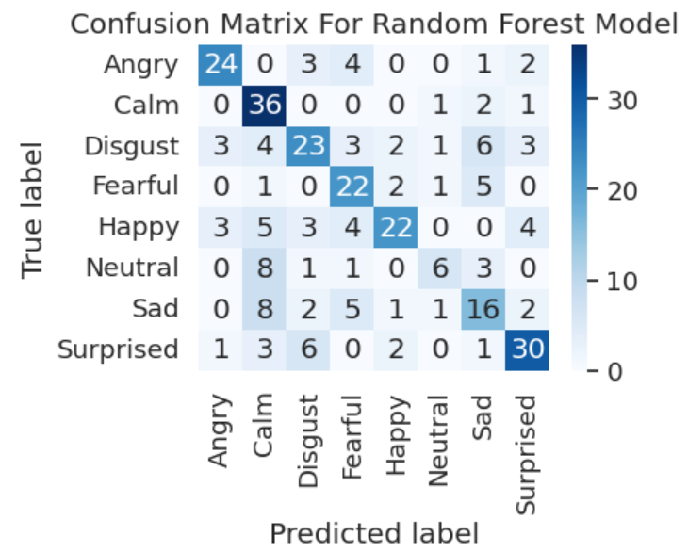
Result (Sentiment Analysis Using Speech)
CNN
K- Nearest Neighbour
Decision Tree
Support Vector Machine
Random Forest

Slide 26
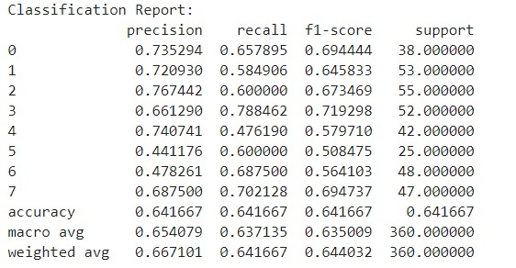
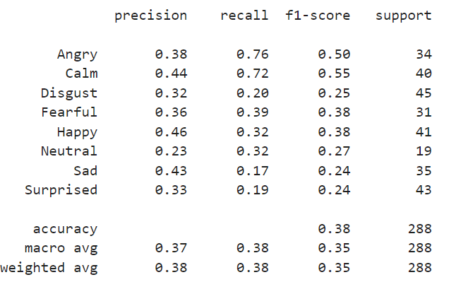
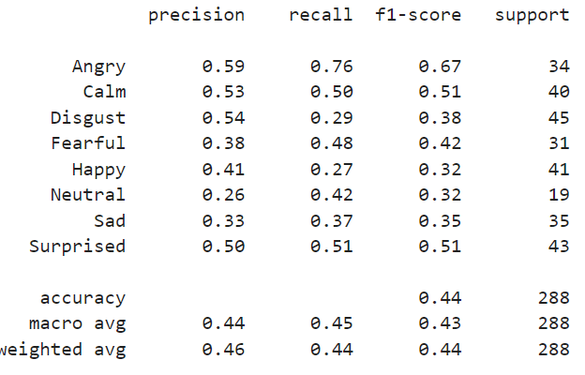
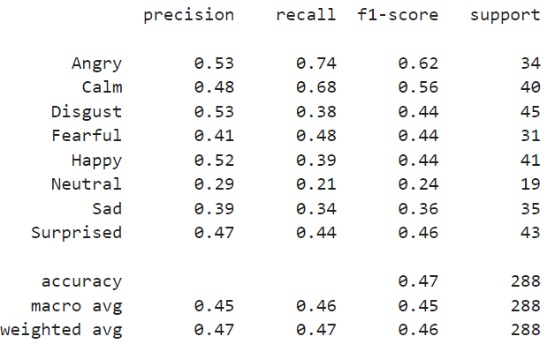
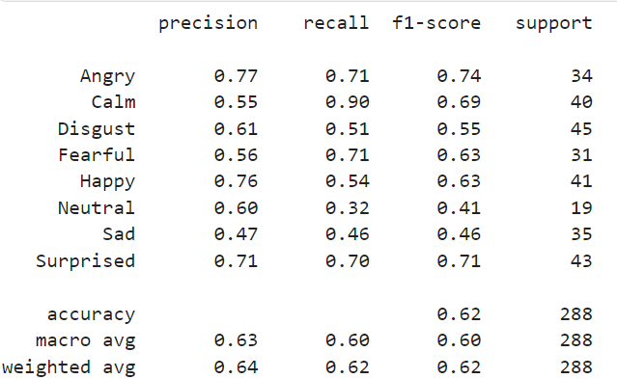
Result (Sentiment Analysis Using Speech)
CNN
K- Nearest Neighbour
Decision Tree
Support Vector Machine
Random Forest

Slide 27
Result (Sentiment Analysis Using Facial Recognition)
Model Comparison for Emotion Classification:
SL NO. | MODEL USED: | ACCURACY | F1-SCORE | PRECISION | RECALL
 | Random Forest | 55% | 0.55 | 0.57 | 0.55
2. | Logistic Regression | 41.32% | 0.40 | 0.41 | 0.41
3. | Decision Tree | 37.25% | 0.39 | 0.38 | 0.37
4. | Support Vector Machine (SVM) | 43.11% | 0.44 | 0.46 | 0.45
5. | K-nearest Neighbor (KNN) Classifier | 46.73% | 0.47 | 0.48 | 0.47
6. | Gradient Boosting | 44.51% | 0.40 | 0.46 | 0.45
7. | CNN | 20.73% | 0.07 | 0.04 | 0.21

Slide 28
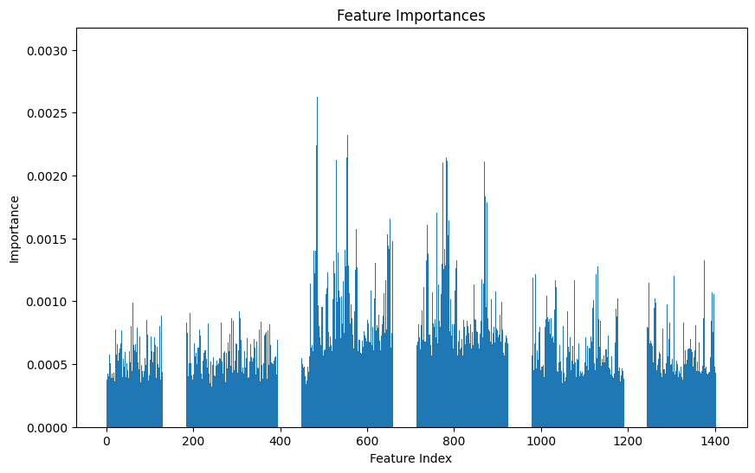
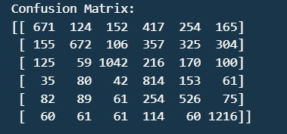
Result (Sentiment Analysis Using Facial Recognition)
The best model we obtained was the Random Forest, which had the highest accuracy and F1-score.

Slide 29
Conclusion and Future Scope
The multi-modal emotion recognition system offers transformative potential in understanding human emotions and holds promise for developing personalized recommendation systems across various media platforms.
Future Scope:
Incorporate deep learning models for accuracy enhancement.
Expand datasets to improve model generalization.
Optimize real-time processing for enhanced user experiences.
Extend the system to develop recommendation systems for music, movies, and books based on users' emotional responses, enhancing personalized experiences across various media platforms.

Slide 30
References
1. Zeeshan Farhan Hanif, Sohelkhan Samirkhan Pathan, Talha Sameer Sayyed, Minhaj Khan, “Emotional Analysis using OpenCV”, International Journal of Novel Research and Development 2013
2. Kaviya P, Arumugaprakash T, “Group Facial Emotion Analysis System Using Convolutional Neural Network”, Fourth International Conference on Trends in Electronics and Informatics (ICOEI 2020)
3. Julio Martínez Zárate, Sandra Mateus Santiago, “Sentiment Analysis Through Machine Learning for the Support on Decision-Making in Job Interviews”, C. Stephanidis (Ed.): HCII 2019, LNCS 11786, pp. 202–213, 2019
4. Dan Duncan, Gautam Shine, Chris English, “Facial Emotion Recognition in Real Time”
5. Umar Rashid; Muhammad Waseem Iqbal; Emotion Detection of Contextual Text using Deep learning.International Symposium on Multidisciplinary Studies and Innovative Technologies (ISMSIT)
6. Minh-Triet Tran-Le; Anh-Tu Doan Lie Detection by Facial Expressions in Real Time 2021 International Conference on Decision Aid Sciences and Application (DASA)

Slide 31
References
7. Shreshth Saxena, Lauren K. Fink, Elke B. Lange, “ Deep learning models for webcam eye tracking in online experiment”, 3 July 2023
8.Midhan, T.M., Selvaraj, P., Raju, M.H.K., Reddy, M.B.P. and Bhaskar, T., 2023, March. Classification of Mental Health and Emotion of Human from Text using Machine Learning Approaches.
9.Acheampong, F.A., Nunoo-Mensah, H. and Chen, W., 2021, December. Recognizing emotions from texts using an ensemble of transformer- based language models. In 2021 18th International Computer Confer- ence on Wavelet Active Media Technology and Information Processing (ICCWAMTIP) (pp. 161-164). IEEE. Journal of Artificial Intelligence and Systems, 2(1), pp.53-79.
10. Saxena, A., Khanna, A. and Gupta, D., 2020. Emotion recognition and detection methods: A comprehensive survey.

